Slide 1

Identifying Age-Related Conditions
Host: Kaggle Stakeholder: InVitro Cell Research
Notes:
Juliana

Slide 2
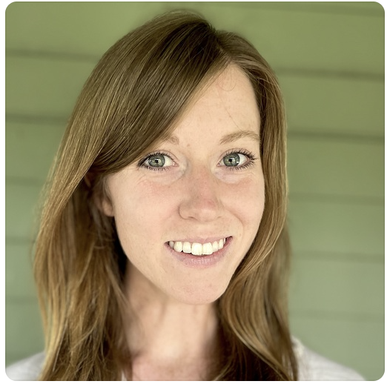


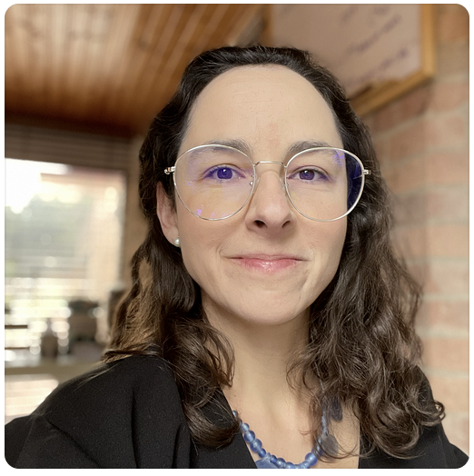
DataSci 207 Team
Darby Brown
Bryan Burzon
Henry Caldera
Juliana Gómez Consuegra
Notes:
Juliana

Slide 3

Goal of the Competition
Our team is entering a Kaggle competition
Competition goals:
Predict the presence of any of three medical conditions using anonymized health data
Help researchers discover the relationship between the anonymized features and the medical conditions
Beat the other 207 team working on this competition. =P
Full details here
Notes:
Juliana
https://www.kaggle.com/competitions/icr-identify-age-related-conditions
To determine if someone has these medical conditions requires a long and intrusive process to collect information from patients. With predictive models, we can shorten this process and keep patient details private by collecting key characteristics relative to the conditions, then encoding these characteristics.

Slide 4
Context
Is age just a number? Aging is a risk factor for multiple ailments.
Bioinformatics field is exploring interventions that can help slow and reverse biological aging and prevent major age-related diseases.
Data science plays a role in developing new methods to solve problems with diverse data, even with limited observations.
Currently, models like XGBoost and random forest are used to predict the presence of medical conditions, but the models don’t consistently meet performance requirements.
In a medical context where lives are on the line, models must make correct predictions reliably and consistently.
Notes:
Darby
They say age is just a number but a whole host of health issues come with aging. From heart disease and dementia to hearing loss and arthritis, aging is a risk factor for numerous diseases and complications. The growing field of bioinformatics includes research into interventions that can help slow and reverse biological aging and prevent major age-related ailments. Data science could have a role to play in developing new methods to solve problems with diverse data, even if the number of samples is small.
Currently, models like XGBoost and random forest are used to predict medical conditions yet the models' performance is not good enough. Dealing with critical problems where lives are on the line, models need to make correct predictions reliably and consistently between different cases.

Slide 5
Driving Motivation
Can we predict the presence of any of three age related conditions?
Current diagnosis approach is a long and intrusive process.
We can shorten this process using predictive modeling.
Keep patient details private by collecting only key characteristics and encrypting their data.
Notes:
Henry
Founded in 2015, the New York City-based competition host, InVitro Cell Research (or ICR), is a company focused on regenerative, and preventive personalized medicine. ICR’s mission is to lead research in bioinformatics to mitigate adverse conditions related to aging.

Slide 6
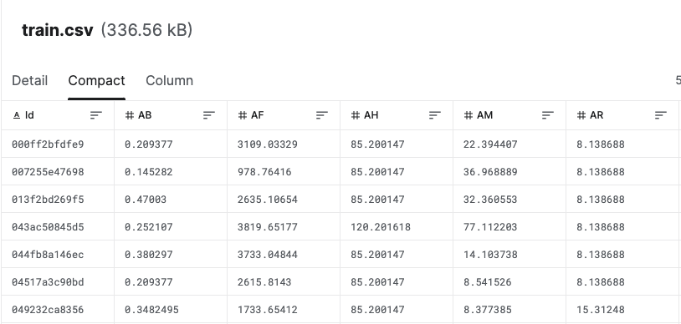
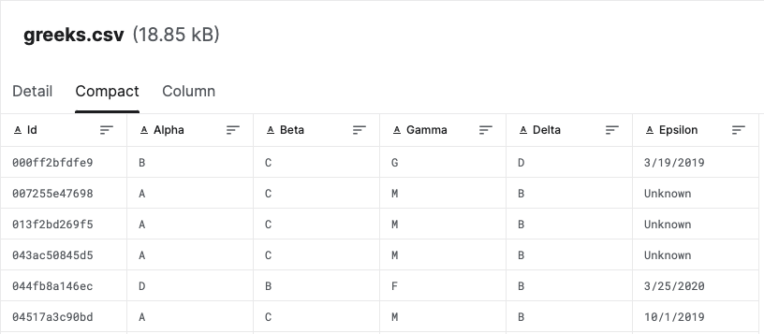
Source of Data
Source: InVitro Cell Research
Full dataset shape is (617, 61):
617 rows
60 features:
56 health characteristics
3 experimental conditions
Date when data was collected
Labels: A binary target:
1:one of the three conditions
0: indicates they have not.
Notes:
Bryan
privately funded company focused on regenerative and preventive personalized medicine

Slide 7
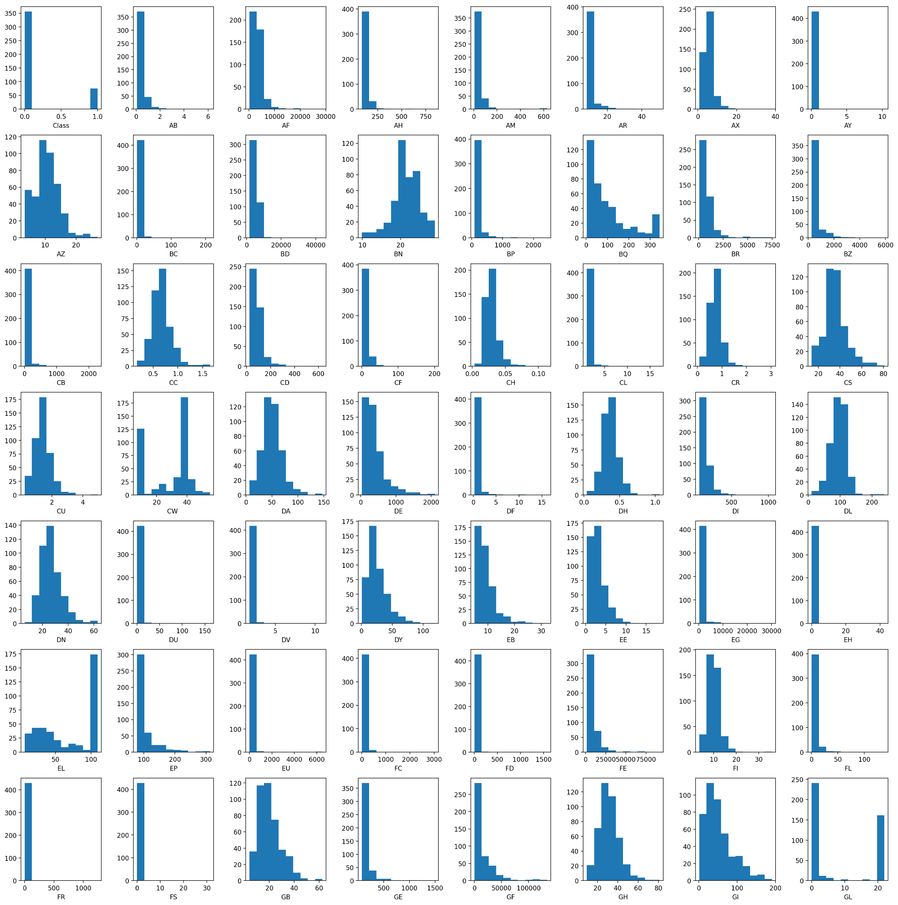
Variable Histograms

Slide 8
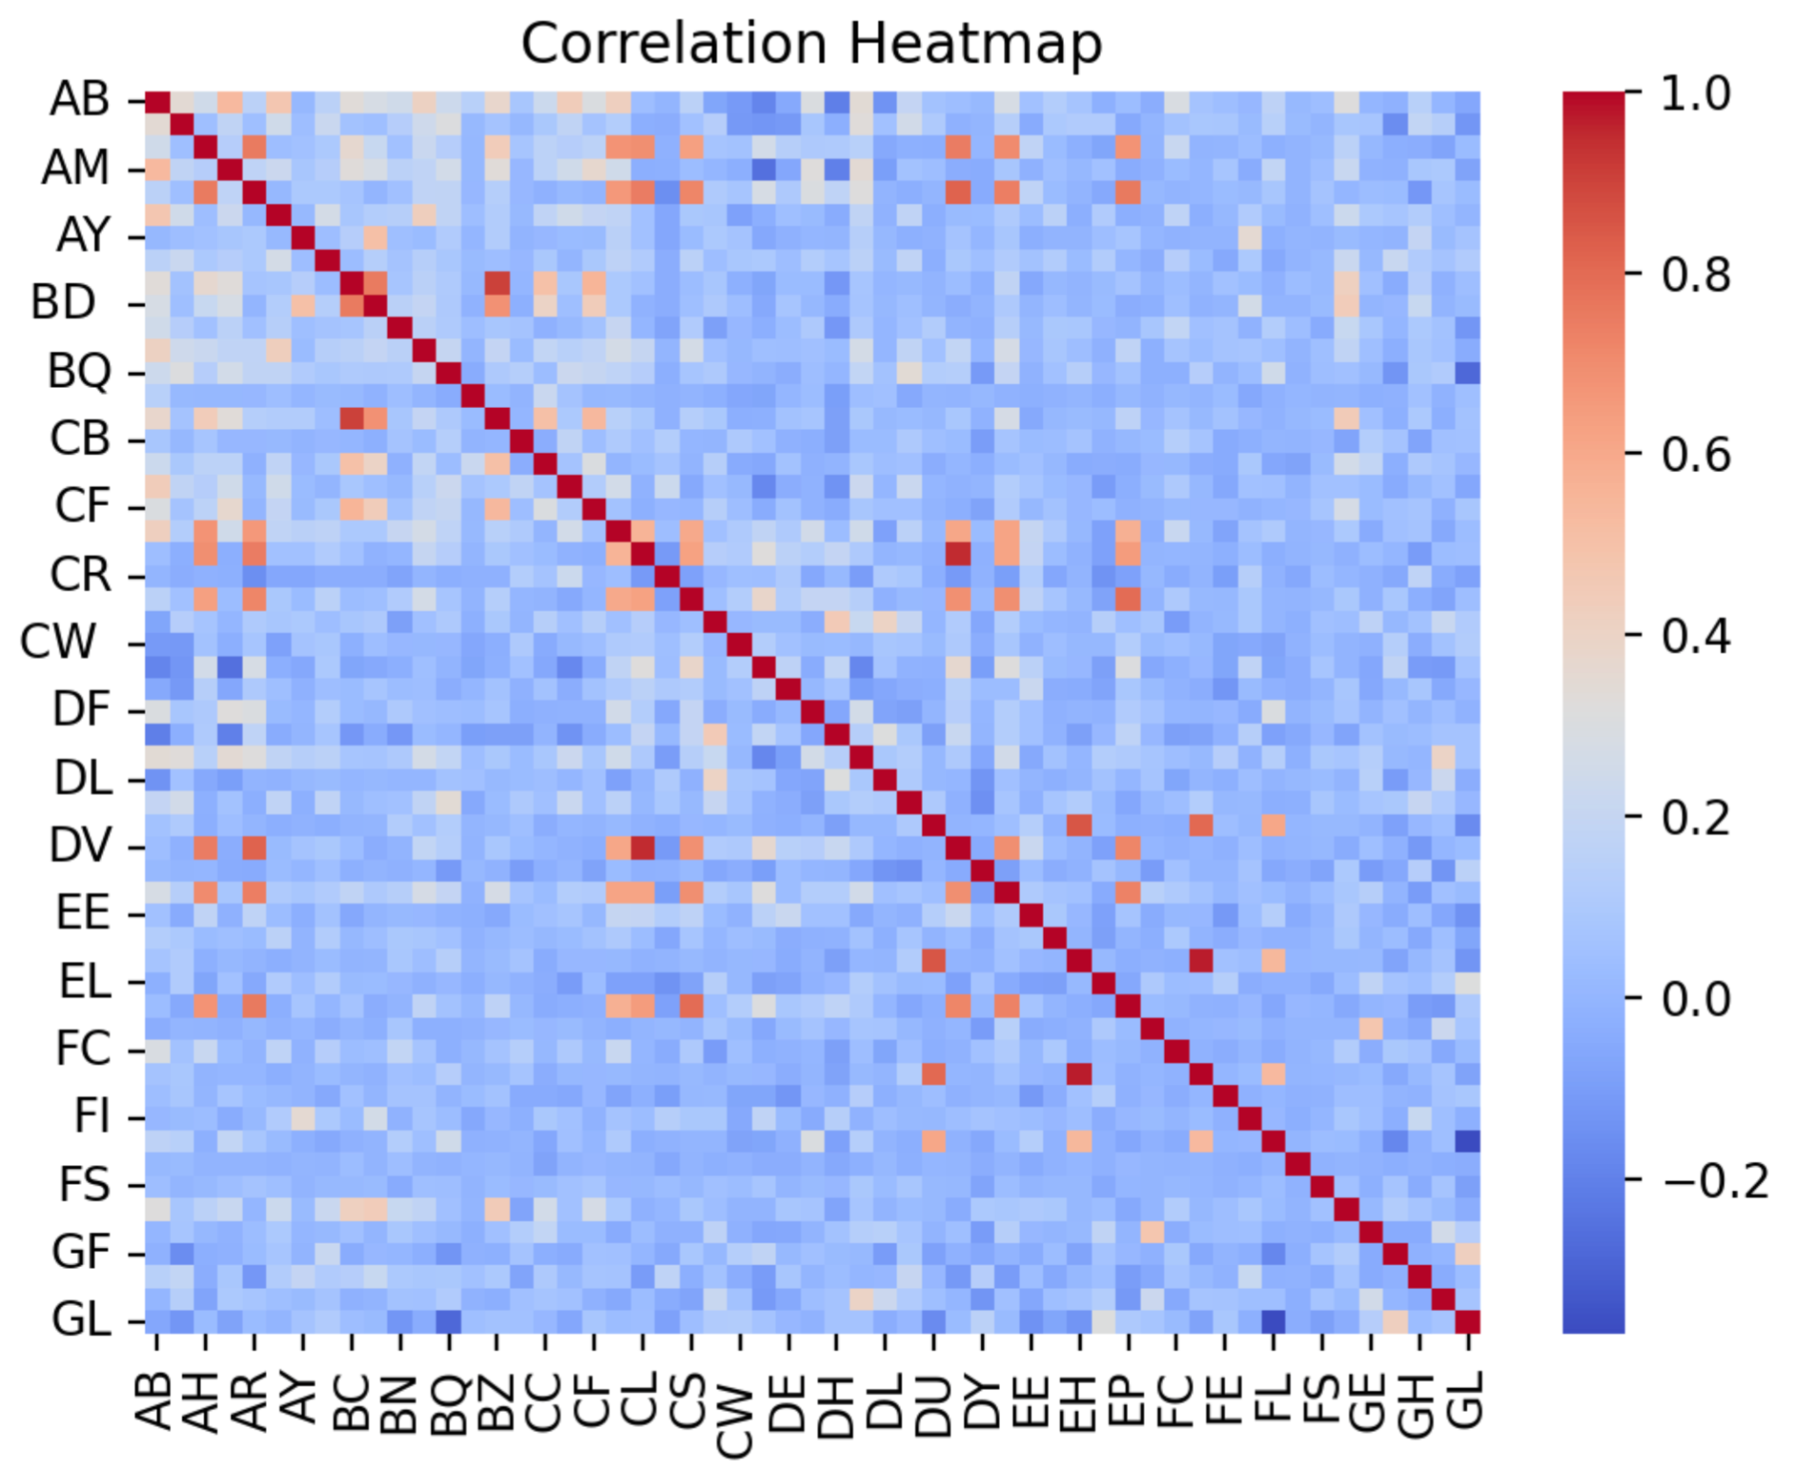
Bivariate Interaction

Slide 9
Training Algorithms
Random Forest w/ Bagging
XGBoost
Perceptron
Multi-layer Perceptron
Notes:
Juliana

Slide 10
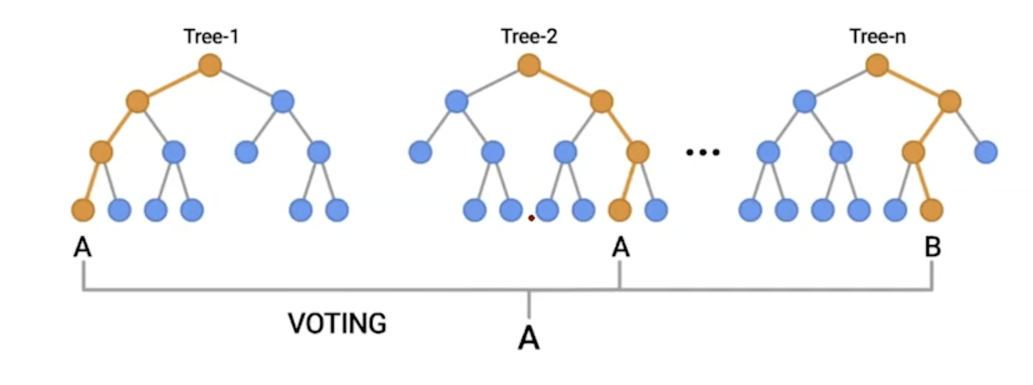
Random Forest with bagging
Ensemble learning method that constructs many decision trees during training, and outputs the mode of the classes.
Robust
No normalization necessary
No need to prune
No need to fine-tune hyperparameters
Notes:
Juliana
RM:
Draw a random bootstrap sample of size n (randomly choose n examples from the training dataset with replacement).
Grow a decision tree from the bootstrap sample. At each node:
Randomly select d features without replacement.
Split the node using the feature that provides the best split according to the objective function, for instance, maximizing the information gain.
Repeat the steps 1-2 n times.
Aggregate the prediction by each tree to assign the class label by majority vote.
Main hyperparameter: number of trees. Other options: size of bootstrap sample, number of features which are randomly chosen for each split

Slide 11
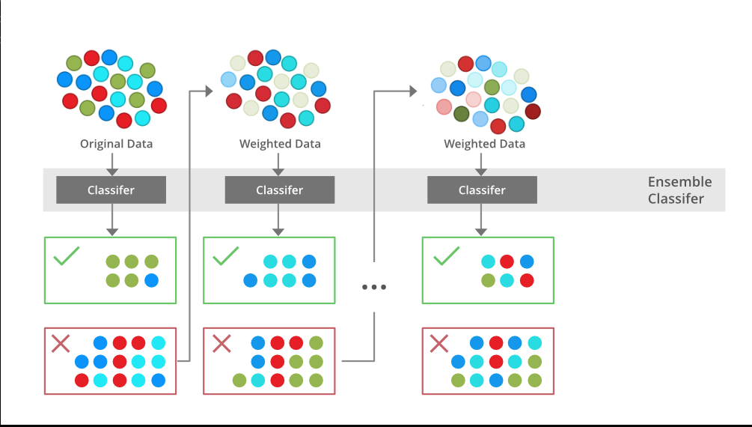
XGBoost
Advantage
Quality results
Lot opportunity for hypertuning
Able to handle missing value
Interpretability
Disadvantage
Computationally intensive
Prone to overfitting
Needs lots memory
Notes:
Bryan
Extreme gradient boosting
Contrary to Bagging
Model train sequentially
Can utilize linear and decision tree

Slide 12
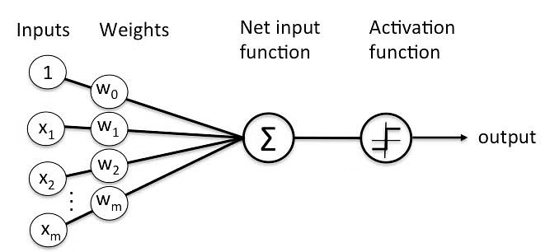
Perceptron
Neural network where each node is a separate linear regression; paired with a nonlinear activation function.
Binary classifier
Facilitates logic functions [AND, OR, NAND, XOR]
Only categorizes sets of vectors that can be separated linearly
Notes:
Darby
What prediction algorithms do you plan to use? Please describe them in detail.
Neural Networks
Basic NN (Darby)

Slide 13
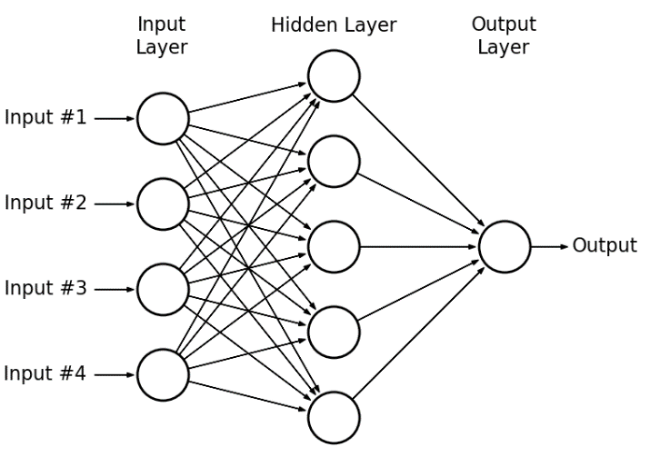
Multilayer Perceptron
Multi-layer, fully connected neural network.
Handles complex networked systems
Capable of handling linearly and non-linearly separable data
Likely too complex given small dataset
Notes:
Darby
Consider including dropout since this NN is highly likely to overfit
What prediction algorithms do you plan to use? Please describe them in detail.
Neural Networks
Basic NN (Darby)

Slide 14
Model Evaluation
In healthcare, false negatives are important and consequential.
Optimize for high sensitivity (recall) and maximize AUPRC (Area Under the Precision-Recall Curve).
When there a class imbalance, it is better to consider AUPRC.
Precision and recall are crucial when the positive class matters more compared to negative.
Few false negatives increases sensitivity.
Notes:
Henry
How will you evaluate your results? Please describe your chosen performance metrics and/or statistical tests in detail.
Considering the role of our model in medical diagnosing, false negatives, are of high importance, and consequence.
We will optimize for high sensitivity, and maximize AUPRC, which stands for Area Under the Precision-Recall Curve. In contrast to a ROC-AUC curve, when there a class imbalance, as there normally are in medical applications, AUPRC is a better metric of performance.
Both precision and recall, are crucial for information retrieval, especially when the positive class matters more compared to the negative class.
Ultimately, optimizing for fewer false negatives, increases the sensitivity.

Slide 15
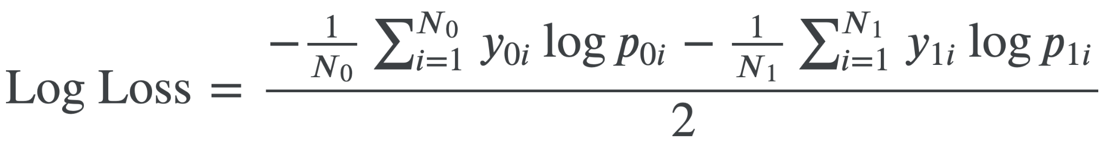
Model Evaluation
Official evaluation metric is balanced Log Loss. The formula for balanced log loss provides a more comprehensive evaluation metric.
Each observation (i) is either of class 0 or of class 1. (N_{c}) is the number of observations of class (c), (y_{c i}) is 1 if observation (i) belongs to class (c) and 0 otherwise, (p_{c i}) is the predicted probability that observation (i) belongs to class (c).
Notes:
Henry
How will you evaluate your results? Please describe your chosen performance metrics and/or statistical tests in detail.
For the purpose of the competition, the official evaluation metric, will be based on balanced Log Loss, which is a variation of Log Loss, that takes class imbalance, into account. The formula for balanced log loss, can vary depending on the specific implementation, but the general idea, is to introduce class weights, into the log loss calculation. Balanced log loss, provides a more-comprehensive evaluation metric, that reflects the performance of a classifier in a more-equitable manner, especially when the class distribution is skewed.

Slide 16
Thank you!
Questions?
Notes:
Juliana

